Slide 1
Software Requirements Analysis, Design and Modeling
Chapter 3.2
Use Case
Notes:
这节课，我们一起学习
第 3.2 章节 第 8 个知识域，用例
//下面是备注
对应课本第 6 章 P45-75

Slide 2
Objectives
Describe the basic Requirements concepts and how they affect Analysis and Design.
Demonstrate how to read and interpret the artifacts of Requirements that are used as a starting point for Analysis and Design.
Identify and write use cases.
Use the brief, casual, and fully dressed formats, in an essential style.
Apply tests to identify suitable use cases.
Relate use case analysis to iterative development.
Notes:
本次课的目标是
1 说明基本的需求概念
以及它们如何影响分析与设计
2 作为分析与设计的出发点
展示如何阅读和解释需求制品
3 确定和编写用例
4 使用摘要、非正式和详述等用例形式的基本式样
5 将测试应用于确定适当的用例上
6 将用例分析与迭代开发联系起来

Slide 3
Content Outline
Introduction of Use Case via a Brief Use Case Example.
Key Concepts about the Use Cases.
Intrduce Use Case Specification via a Fully Dressed UC1: Process Sale.
Guidelines about Use Cases.
Use Cases: A Case Study Applying UML Notations.
Process: Use Cases in Iterative Methods.
Notes:
首先
通过一个摘要形式的用例实例
介绍用例

Slide 4
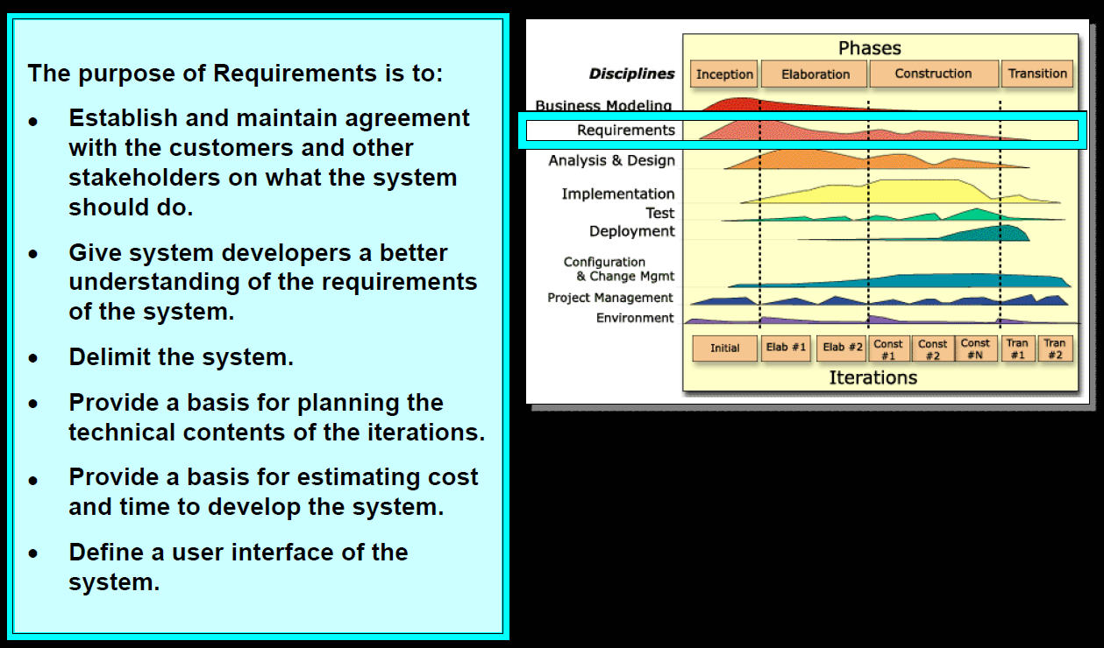
Requirements in UP Context
The UP defines the Use-Case Model within the Requirements discipline.
Notes:
UP 场景下的需求
需求的目的是
建立和维护客户与其它涉众
关于系统应该做什么的协议
为系统开发者提供
对系统需求更好的理解
界定系统的范围
提供规划迭代技术内容的基础
定义系统的用户界面
UP在需求科目中定义了
用例模型为基础的需求

Slide 5
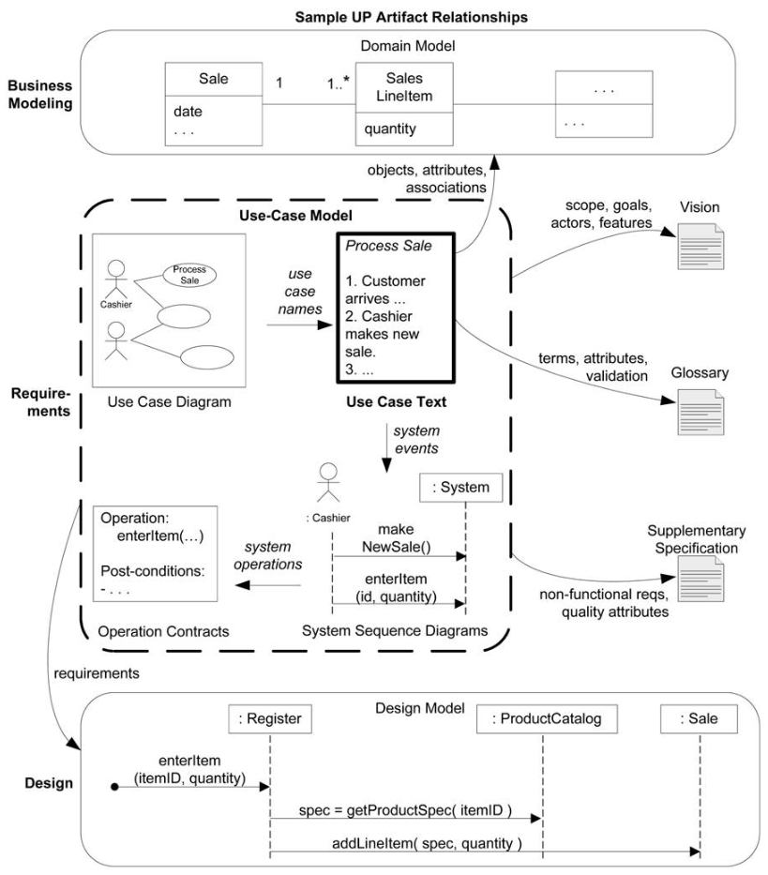
A Brief Use Case Example: Process Sale
Informally, use cases are text stories of some actor using a system to meet goals.
Process Sale: A customer arrives at a checkout with items to purchase. The cashier uses the POS system to record each purchased item. The system presents a running total and line-item details. The customer enters payment information, which the system validates and records. The system updates inventory. The customer receives a receipt from the system and then leaves with the items.
Relevant Requirements Artifacts
Use Case Model
Figure 6.1. Sample UP artifact influence.
Notes:
通俗地讲，用例是文本形式的情节描述
用以说明某参与者使用系统以实现某些目标
如图所示
UP 制品的影响力
说明了UP制品之间的关系
重点关注 黑框部分 特别强调了
文本摘要形式的用例
处理销售用例
该用例说明了
顾客携带所购商品到达收银柜台
直至
顾客从系统得到购物小票
然后携带商品离开
等一系列活动
在这个描述中，涉及到了
有关用例的基本概念
参与者 例如 顾客
场景 例如 顾客携带所购商品到达收银柜台
用例活动和活动结果等
另外，用例也可以
通过用例图来辅助表示
如红色框标注
用例规约以及相关的辅助图
例如：用例图，系统时序图，活动图等
构成了用例模型
最后，与用例相关的需求制品
如图 绿色部分的标注 所示
用例之外的需求制品
我们已经在3.1节做过介绍
请大家回忆
用例模型及其相关的其它需求制品
是 OOA/D 的出发点
// 备注
处理销售用例
顾客携带所购商品到达收银柜台
收银员使用 POS 系统记录每件商品
系统连续显示累计金额
并逐行显示细目
顾客输入支付信息
系统对支付信息进行验证和记录
系统更新库存信息
顾客从系统得到购物小票
然后携带商品离开

Slide 6
Are Use Cases Functional Requirements?
Use cases are requirements, primarily functional or behavioral requirements that indicate what the system will do.
In terms of the FURPS+ requirements types, they emphasize the "F" (functional or behavioral), but can also be used for other types, especially when those other types strongly relate to a use case.
In the UP and many modern methods use cases are the central mechanism that is recommended for their discovery and definition.
A related viewpoint is that a use case defines a contract of how a system will behave [Cockburn01].
Notes:
这些用例就是需求
主要说明系统如何工作的功能性或行为性需求
按照 FURPS+ 需求类型
用例强调了F，即功能性或行为性
但也可以用于其他类型
特别是与用例紧密相关的那些类型
在UP和许多现代的方法中
用例是发现和定义需求的核心机制
Couckburn 提出了一种相关的观点
认为 用例定义了系统行为的契约

Slide 7
Content Outline
Introduction of Use Case via a Brief Use Case Example.
Key Concepts about the Use Cases.
Introduce Use Case Specification via a Fully Dressed UC: Process Sale.
Guidelines about Use Cases.
Use Cases: A Case Study Applying UML Notations.
Process: Use Cases in Iterative Methods.
Notes:
下面介绍
用例的关键概念

Slide 8
What Is System Behavior?
System behavior is how a system acts and reacts.
It is the outwardly visible and testable activity of a system.
System behavior is captured in use cases.
Use cases describe the system, its environment,
and the relationship between the system and its
environment.
Notes:
系统的行为
有关系统如何活动和响应
它是对外可见而且可以测试的系统活动
系统行为可以通过一些用例来捕捉
这些用例描述系统，系统所处环境
以及系统与环境之间的关系

Slide 9
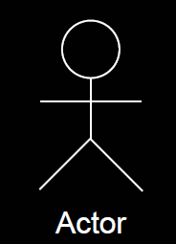
What are Actors?
Actors
An actor is something with behavior, such as a person (identified by role), computer system, or organization; for example, a cashier
What are Three Kinds of Actors?
Primary actor
Supporting actor
Offstage actor
Notes:
参与者是某些具有行为的事物
可以是人（通过角色标识）
计算机系统或组织，例如收银员
参与者可以分为
主要参与者 协助参与者
和幕后参与者三大类
//以下是备注
主要参与者
具有用户目标 并通过使用 所讨论系统 的服务完成
例如 收银员
其目的是发现驱动用例的用户目标
协助参与者
为所讨论系统提供服务 例如信息服务
其目的是明确外部接口和协议 例如 自动付费授权服务
协助参与者通常是计算机系统，但也可以是组织或人
幕后参与者
在用例行为中具有影响或利益 但不是主要或协助参与者
例如政府税收机构
其目的是确保确定并满足所有必要的重要事物
如果不明确对幕后参与者进行命名
则有时很容易忽略其影响或利益
Scenarios
A scenario is a specific sequence of actions and interactions between actors and the system; it is also called a use case instance. It is one particular story of using a system, or one path through the use case; for example, the scenario of successfully purchasing items with cash, or the scenario of failing to purchase items because of a credit payment denial.
Use Cases
A use case is a collection of related success and failure scenarios that describe an actor using a system to support a goal.
A set of use-case instances, where each instance is a sequence of actions a system performs that yields an observable result of value to a particular actor [RUP].
参与者是某些具有行为的事物
可以是人（通过角色标识）
计算机系统或组织，例如收银员
场景是参与者与系统之间的
一系列特定的活动和交互
也称为用例实例

Slide 10
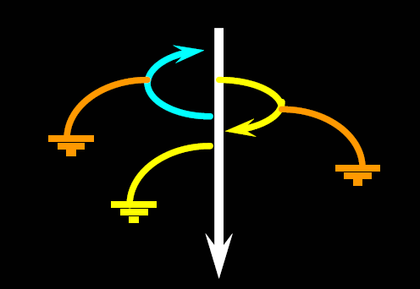
What are Use-Case Flow of Events?
Has one normal, basic flow, Main Success flow
Several alternative flows
Regular variants
Odd cases
Exceptional flows for handling error situations
Notes:
用例的事件流
包括正常的（也称为基本的 或 主成功的）事件流
和一些替代的事件流
替代的事件流分为
规则的和不规则的事件流
和处理错误情况的异常事件流

Slide 11
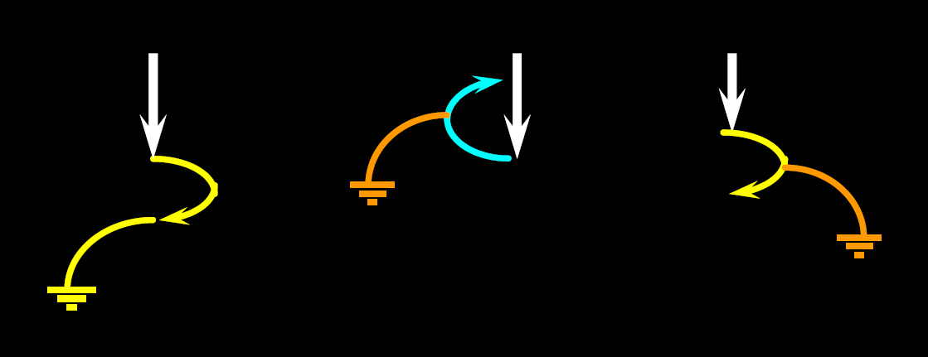
What are Scenarios?
Scenarios
A scenario is a specific sequence of actions and interactions between actors and the system; it is also called a use case instance.
Notes:
场景是参与者与系统之间的
一系列特定的活动和交互
也称为用例实例
//备注
It is one particular story of using a system, or one path through the use case; for example, the scenario of successfully purchasing items with cash, or the scenario of failing to purchase items because of a credit payment denial.

Slide 12
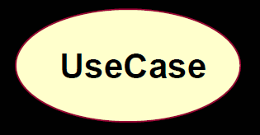
What are Use Cases?
Use Cases
A use case is a collection of related success and failure scenarios that describe an actor using a system to support a goal.
A Use Case is a set of use-case instances, where each instance is a sequence of actions a system performs that yields an observable result of value to a particular actor [RUP].
Notes:
用例
用例是一组
相关的成功或失败的场景集合
用来描述参与者
如何使用系统来实现其目标
一组用例的实例
其中每个实例都是
系统执行的一系列活动
这些活动产生了
对某个参与者而言
可观察的返回值
在UML中使用
象一个鸡蛋的
椭圆表示

Slide 13
UC Handle Returns: A Casual Format Use Case Example
Handle Returns
Main Success Scenario:
A customer arrives at a checkout with items to return. The cashier uses the POS system to record each returned item …
Alternate Scenarios:
If the customer paid by credit, and the reimbursement transaction to their credit account is rejected, inform the customer and pay them with cash.
If the item identifier is not found in the system, notify the Cashier and suggest manual entry of the identifier code (perhaps it is corrupted).
If the system detects failure to communicate with the external accounting system, …
Notes:
处理退货用例
一种非正式形式的用例实例
主成功场景
顾客成功退货
替换场景
由于信用卡或者POS系统的问题
不能够正常退货

Slide 14
Notation: What are Three Common Use Case Formats?
Use cases can be written in different formats and levels of formality:
brief Terse one-paragraph summary, usually of the main success scenario. The prior Process Sale example was brief.
When? During early requirements analysis, to get a quick sense of subject and scope. May take only a few minutes to create.
casual Informal paragraph format. Multiple paragraphs that cover various scenarios. The prior Handle Returns example was casual.
When? As above.
fully dressed All steps and variations are written in detail, and there are supporting sections, such as preconditions and success guarantees.
When? After many use cases have been identified and written in a brief format, then during the first requirements workshop a few (such as 10%) of the architecturally significant and high-value use cases are written in detail.
Notes:
用例能够以不同格式
或形式化程度进行编写
有三种常用形式：摘要、非正式和详述三种形式
//下面备注
摘要
简洁的一段式概要
通常用于主成功场景
何时使用？在早期需求分析过程中，为快速了解主题和范围
可能只需要几分钟进行编写
例如 前例中的处理销售用例
非正式
非正式的段落格式，用几个段落覆盖不同的场景
例如课本中的处理退货例子
何时使用？同上
详述
详细编写所有步骤及各种变化
同时具有补充部分
如前置条件和成功保证
何时使用？
确定并以摘要形式编写了大量用例之后
在第一次需求讨论会中
详细地编写其中少量的
具有重要架构意义和高价值的用例

Slide 15
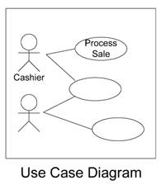
What is a Use-Case Model?
A model of the system’s intended functionality
(use cases) and its environment (actors)
Primarily, this is the set of all written use cases; it is a model of the system's functionality and environment.
Notes:
用例模型是系统的期望功能
包括用例及其环境（参与者）
基本上 他是一组用例文本
是系统功能与环境的模型
可以采用UML用例图来建模表示

Slide 16
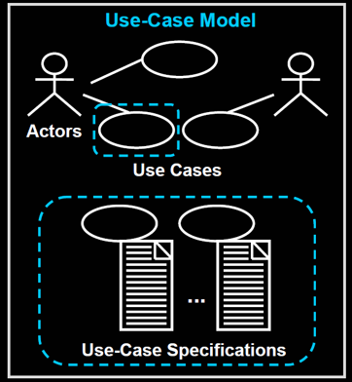
Use Cases and Use Case Model and Use Cases Specification
Use cases are text documents, not diagrams, and use-case modeling is primarily an act of writing text, not drawing diagrams.
The Use-Case Model is not the only requirement artifact in the UP. There are also the Supplementary Specification, Glossary, Vision, and Business Rules. These are all useful for requirements analysis, but secondary at this point.
There is nothing object-oriented about use cases; But use cases are a key requirements input to classic OOA/D.
Notes:
下面做个小结
用例是一些文本
而非图形
用例建模主要是编写文本的活动
而非制图
用例模型不是UP的唯一需求制品
此外 还有
补充规约，词汇表，设想和业务规则等
但这些制品对于面向对象分析和设计而言
居于次要位置
用例并不是面向对象的，但用例是
面向对象分析与设计经典方法的主要需求

Slide 17
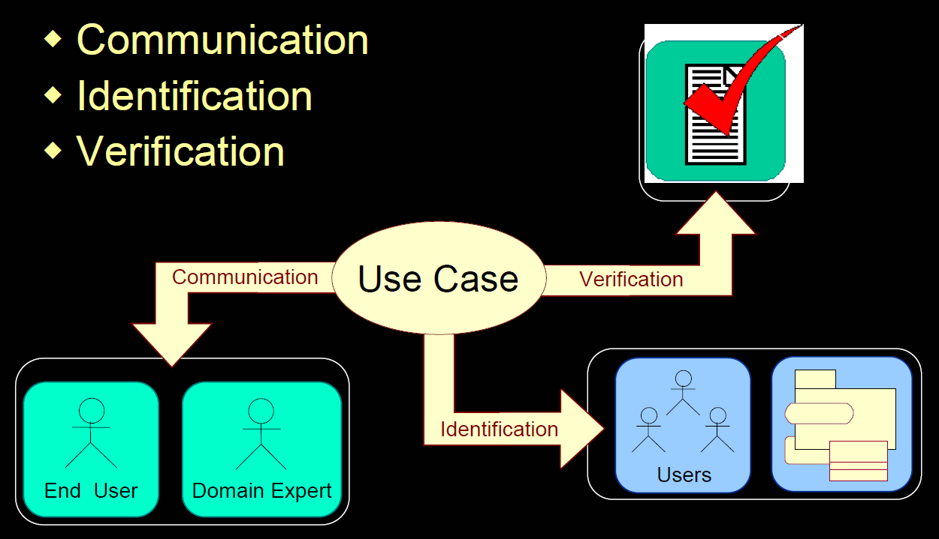
Motivation: Why Use Cases (or Use Model)?
Notes:
用例模型的好处
1 促进沟通
用例强调了终端用户的目标和观点
有助于让终端用户和领域专家
参与到软件项目中来
促进团队成员对需求的充分沟通
2 有助于标识
有助于保持简洁，并使领域专家或需求提供者
能够自己编写或参与编写用例
3 有助于验证
有助于验证正确性
例如需求的正确性 一致性和完整性
需求与设计和实现的一致性等
大家可以而且应该在实践中
进一步体会用例的好处

Slide 18
Content Outline
Introduction of Use Case via a Brief Use Case Example.
Key Concepts about the Use Cases.
Introduce Use Case Specification via a Fully Dressed UC: Process Sale.
Guidelines about Use Cases.
Use Cases: A Case Study Applying UML Notations.
Process: Use Cases in Iterative Methods.
Notes:
下面
通过一个详细描述的用例
介绍用例规约

Slide 19
A Format Template for Detailed Use Case Specification
Use Case Section | Comment
Use Case Name | Start with a verb.
Scope | The system under design.
Level | "user-goal" or "subfunction"
Primary Actor | Calls on the system to deliver its services.
Stakeholders and Interests | Who cares about this use case, and what do they want?
Preconditions | What must be true on start, and worth telling the reader?
Success Guarantee | What must be true on successful completion, and worth telling the reader.
Main Success Scenario | A typical, unconditional happy path scenario of success.
Extensions | Alternate scenarios of success or failure.
Special Requirements | Related non-functional requirements.
Technology and Data Variations List | Varying I/O methods and data formats.
Frequency of Occurrence | Influences investigation, testing, and timing of implementation.
Miscellaneous | Such as open issues.
Notes:
用例的组成部分
用例名称
范围
级别
主要参与者
涉众及其关注点
前置条件
成功保证（后置条件）
主成功场景
扩展
特殊需求
技术和数据变元表
发生频率
杂项

Slide 20
POS Example: (Partial) Fully Dressed Style Use Case Specification
Flipped Class
For more detail, please refer to the Process Sale.docx.
Please read the Use Case Specification example to answer the following questions.
Read the following PPT about UC1
Notes:
POS 例子 （部分）详细的用例规约
这部分内容将采用 翻转课堂 方式教学
为了了解更多细节内容
请参考 补充规约.docx 文档
请阅读 补充规约 的例子，回答下面的问题
阅读下面PPT

Slide 21
Use Case UC1: Process Sale Flipped Course Questions
Please describe what do the sections of the template mean, according to UC1,which is the primary case study example of a detailed use case.
Can you give one more scenario example for the alternate scenarios of success or failure for UC1?
IF we are considering the requirements
customer's interest for a visible display of descriptions and prices
THEN where should the requirements be captured?
in the Extensions of the UC1
in the Special Requirements of the UC1
in the Supplementary Specification
Notes:
用例 UC1：处理销售的翻转课堂的问题
请根据详细风格描述的用例1
说明用例模板各个组成部分的含义
请为UC1
额外给出1个成功或失败
替换场景的场景实例
考虑需求
客户要求显示商品描述和价格
那么该需求应在哪里捕获
UC1用例的扩展
UC1用例的特别需求
补充规约

Slide 22
UC1: Process Sale, Fully Dressed Style-1
Use Case UC1:
Process Sale
Scope:
NextGen POS application
Level:
user goal
Primary Actor:
Cashier
Stakeholders and Interests:
Preconditions:
Cashier is identified and authenticated.
Success Guarantee (or Postconditions):
Sale is saved. Tax is correctly calculated. Accounting and Inventory are updated. Commissions recorded. Receipt is generated. Payment authorization approvals are recorded.
Notes:
请带上某个涉众的帽子
表达该涉众的关注点

Slide 23
UC1: Process Sale, Fully Dressed Style-2
Main Success Scenario (or Basic Flow):
Customer arrives at POS checkout with goods and/or services to purchase.
Cashier starts a new sale.
Cashier enters item identifier.
…
Extensions (or Alternative Flows):
*a. At any time, Manager requests an override operation:
*b. At any time, System fails:
Special Requirements:
Language internationalization on the text displayed.
Notes:
请回答在扩展事件流中
* 表示什么含义？

Slide 24
UC1: Process Sale, Fully Dressed Style-3
Technology and Data Variations List:
*a. Manager override entered by swiping an override card through a card reader, or entering an authorization code via the keyboard.
Frequency of Occurrence:
Could be nearly continuous.
Open Issues:
What are the tax law variations?
Notes:
这是处理销售用例的其它内容

Slide 25
Content Outline
Introduction of Use Case via a Brief Use Case Example.
Key Concepts about the Use Cases.
Introduce Use Case Specification via a Fully Dressed UC: Process Sale.
Guidelines about Use Cases.
Use Cases: A Case Study Applying UML Notations.
Process: Use Cases in Iterative Methods.
Notes:
下面
介绍关于用例的准则

Slide 26

Guideline: How to Write Use Cases
Write use cases in an essential style; keep the user interface out and focus on actor intent.
Write Terse Use Cases.
Write Black-Box Use Cases.
Take an Actor and Actor-Goal Perspective.
Notes:
编写用例的准则
以本质风格编写用例
摒除用户界面
并且关注参与者的意图
编写简洁的用例
编写黑盒用例
采用参与者和参与者目标的视角

Slide 27
Guideline: How to Find Use Cases
Use cases are defined to satisfy the goals of the primary actors. Hence, the basic procedure is:
Choose the system boundary. Is it just a software application, the hardware and application as a unit, that plus a person using it, or an entire organization?
Identify the primary actors those that have goals fulfilled through using services of the system.
Identify the goals for each primary actor.
Define use cases that satisfy user goals; name them according to their goal. Usually, user-goal level use cases will be one-to-one with user goals, but there is at least one exception, as will be examined.
In UP, not all goals or use cases will be fully or correctly identified near the start. It's an evolving discovery.
Notes:
为满足主要参与者的目标而
定义用例
因此，基本的过程如下
1）选择系统边界
2）确定主要参与者
3）确定每个主要参与者的目标
4）定义满足用户目标的用例，根据其目标对用例命名
在UP中，在开始阶段
不必完整或准确地定义
所有目标或用例
这是不断深入发掘的过程

Slide 28
Step 1: Choose the system boundary.
For this case study, the POS system itself is the system under design; everything outside of it is outside the system boundary, including the cashier, payment authorization service, and so on.
If the definition of the boundary of the system under design is not clear, it can be clarified by further definition of what is outside the external primary and supporting actors.
Notes:
对于本案例研究，POS系统是被设计的系统
任何系统之外的事物都在系统边界之外
包括收银员、支付授权系统等
如果被设计系统的边界定义不清晰
那么可以通过此后对系统外部
主要参与者和协助参与者的定义加以明确

Slide 29
Steps 2 and 3: Find Primary Actors and Goals
The following questions help identify actors and Goals:
Who starts and stops the system?
Who does user and security management?
Who does system administration?
Is "time" an actor because the system does something in response to a time event?
Is there a monitoring process that restarts the system if it fails?
How are software updates handled? Push or pull update?
In addition to human primary actors, are there any external software or robotic systems that call upon services of the system?
Who evaluates system activity or performance?
Who evaluates logs? Are they remotely retrieved?
Who gets notified when there are errors or failures?
Actors and Goals can be organized at least two approaches:
Draw them in a use case diagram, naming the goals as use cases
Write an actor-goal list first, review and refine it, and then draw the use case diagram.
Notes:
下列问题有助于确定
其他可能会遗漏的参与者和目标
谁来启动和停止系统？
谁来完成用户管理和安全管理？
谁来完成系统管理？
“时间”是参与者吗？因为系统要响应时间事件
而完成某些活动
当系统失败时
是否存在监控进程将系统重新启动？
软件升级是如何处理的？是“推模式”还是“拉”模式？
除了人作为主要参与者外，还有其它外部的软件或自动机器系统
调用该系统的服务吗？
谁来考察系统活动或性能？
谁来考察日志？
是否可以远程检索？
系统发生错误或故障时应通知谁？
至少有两种方法可以组织参与者和目标
绘制用例图，以目标作为用例名称
首先写出参与者-目标列表，复查并精化之，然后绘制用例图

Slide 30
Step 4: Define Use Cases
In general, define one use case for each user goal. Name the use case similar to the user goal for example, Goal: process a sale; Use Case: Process Sale.
A common exception to one use case per goal is to collapse CRUD (create, retrieve, update, delete) separate goals into one CRUD use case, idiomatically called Manage <X>. For example, the goals "edit user," "delete user," and so forth are all satisfied by the Manage Users use case.
Notes:
一般来说
为每个用户目标分别定义用例
用例的名称应该和用户目标类似
例如，
目标 处理销售；
用例：处理销售
通常一个目标对应一个用例
但常见一个例外的情况是
将分散的 CRUD 创建、检索、更新和删除目标
合并为一个CRUD用例，并习惯性地称为管理<X>.
例如，管理用户用例可以同时满足 编辑用户 删除用户等目标

Slide 31
Guideline: What Tests Can Help Find Useful Use Cases?
The Boss Test
The use case fails the Boss Test, which implies it is not strongly related to achieving results of measurable value.
The EBP Test
Elementary Business Process
Focus on use cases that reflect EBPs.
The Size Test
A use case typically contains many steps, and in the fully dressed format will often require 3-10 pages of text.
Which of these is a valid use case?
Negotiate a Supplier Contract
Handle Returns
Log In
Move Piece on Game Board
Notes:
什么样的测试有助于发现有用的用例
老板测试
如果用例 不会通过老板测试
这意味着 该用例与达到可量化价值的结果 没有太大的关系
EBP 测试
EBP 是一个人在某个时刻 某个地点执行的任务
用以响应业务事件
该任务能够增加可量化的业务价值
规模测试
用例通常包含多个步骤
在详述形式的用例中，通常需要3-10文本
换言之，如果一个待标识的用例只包含很少的简单步骤
那么，该用例很可能只是某个用例的步骤，而不应该单独成为一个用例
下面哪个是有效的用例
1 就供应者合同进行协商
比EBP更加广泛，用时更长。更适合作为业务用例，而非系统用例
2 处理退货
能够通过老板测试 看上去与EBP类似，规模合适
3 登录
如果你一整天都在登录，显然老板不会满意
4 在游戏板上移动棋子
单一步骤，不能通过规模测试
因此，综上所述，处理退货 是有效的用例

Slide 32
Content Outline
Introduction of Use Case via a Brief Use Case Example.
Key Concepts about the Use Cases.
Introduce Use Case Specification via a Fully Dressed UC: Process Sale.
Guidelines about Use Cases.
Use Cases: A Case Study Applying UML Notations.
Process: Use Cases in Iterative Methods.
Notes:
下面介绍
用例：应用UML表示法的一个案例研究

Slide 33
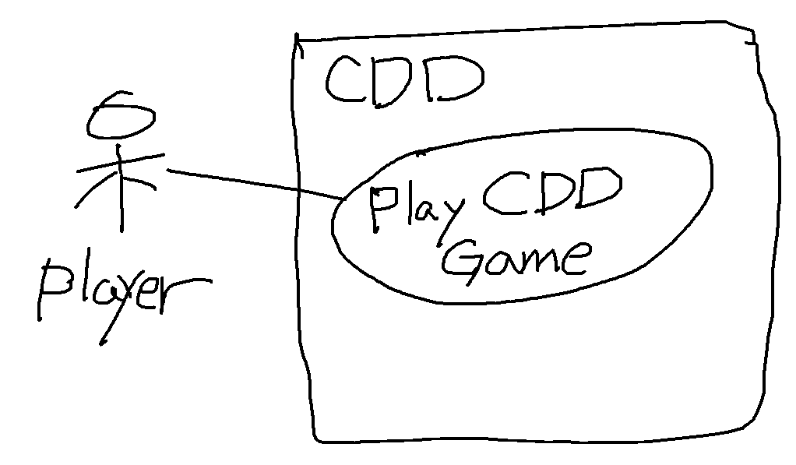
Use case diagram for CDD Game system.
Figure: Use case diagram ("context diagram") for CDD Game system.
Notes:
可以采用用例图
对课程2.1节介绍的锄大地游戏案例
进行建模
如图所示
游戏玩家
通过用例 Play CDD Game
与CDD系统进行交互

Slide 34
Use Case UC2: Play CDD Game.
Scope: CDD Poke Game System
Level: User Goal
Actors: Player
Basic Events Flow
Start Game
A player could select 3 robot playmates and start to play the game. Also, a player could enter the game or register himself by giving a nick name, select a nick name, set the background music to initiate the game.
When a player and the 3 selected robots play the game, each of them is distributed with 13 cards at random.
Play Game Turn
When the player takes the turn to show cards, the player selects a group of cards and show it. The group of cards should be validated by the type of card, which is established by the rules of CDD game.
End Game Turn
When one of the actors has showed all of the cards on hand, the game is over and the system will calculate the score of each player according to the game rules.
All of the registered players are ranked with the scores they have won.
Exit Game
Players can decide to leave or continue the game.
Extensive Events Flow
Escape from the Game
If a player leaves the game before the end of the game, he or she would be given penalty.
Notes:
采用前面描述方法
可以创建用例文本
假设我们设计一款离线的扑克牌游戏
名字简称为 CDD
玩家和 3 个机器人玩友
在牌桌上 使用 52 张牌（去掉 大、小 王）
进行游戏
开始游戏玩家可以选择3个机器人玩友开始游戏
另外，玩家可以通过输入昵称，设置背景音乐
初始化游戏
进行某个轮次游戏
当玩家开始与3个机器人玩友开始游戏时
系统随机向4个参与者发13张牌
当玩家接管牌并出牌时
玩家选择一组牌并且出牌
牌的组合应该通过牌型验证
这些牌型通过锄大地游戏规则来确定
当任何一个参与者出示了手中所有的牌
那么该轮次的游戏结束
系统根据游戏规则计分
结束某轮次的游戏
任何一个玩家出示完手中的牌 表示该轮次游戏结束
这时，系统将根据游戏规则计算分数
并且，玩家可以决定继续游戏或者退出游戏
如果玩家在某个轮次游戏结束之前离开游戏
玩家将被罚款
系统将根据积分
对所有的注册用户进行排名
// 以下备注
请参考UML活动图
CDD 扑克牌游戏的规则 需要记录在这里吗？
首先，游戏规则是领域规则
有时也称为业务规则
在UP中 领域规则可以作为补充性规格说明的一部分

Slide 35
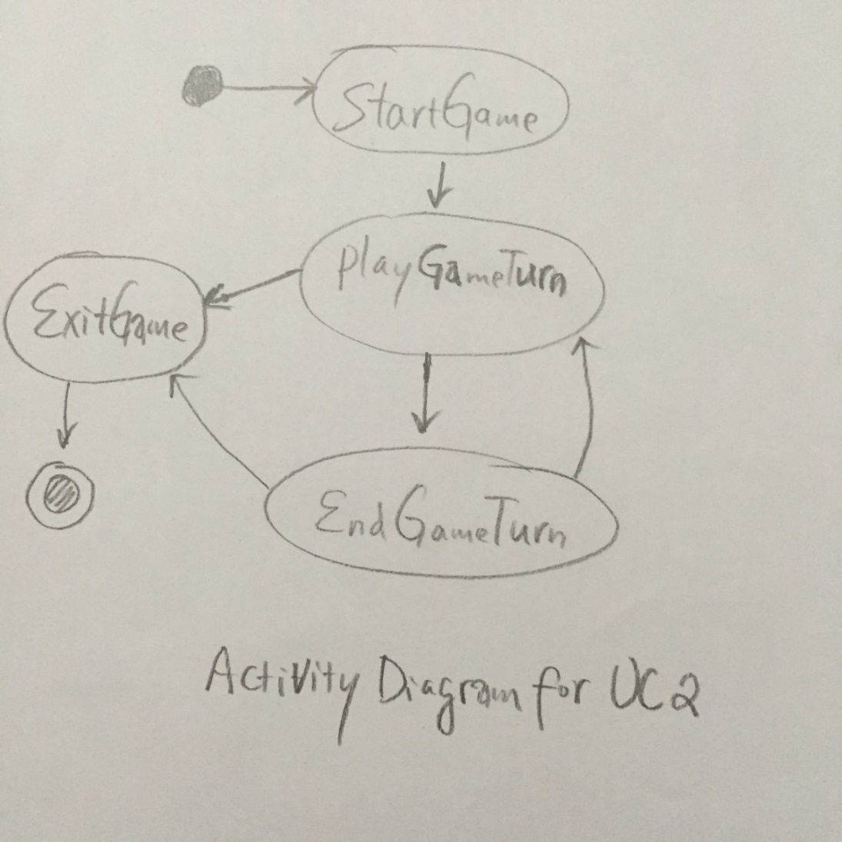
Activity Diagram of UC2
Notes:
UML活动图
能够直观展示UC2的事件流
主事件流包括
开始游戏
进行某个轮次游戏
结束某个轮次游戏
退出游戏等
替代事件流
是其中的一条逃跑路线

Slide 36
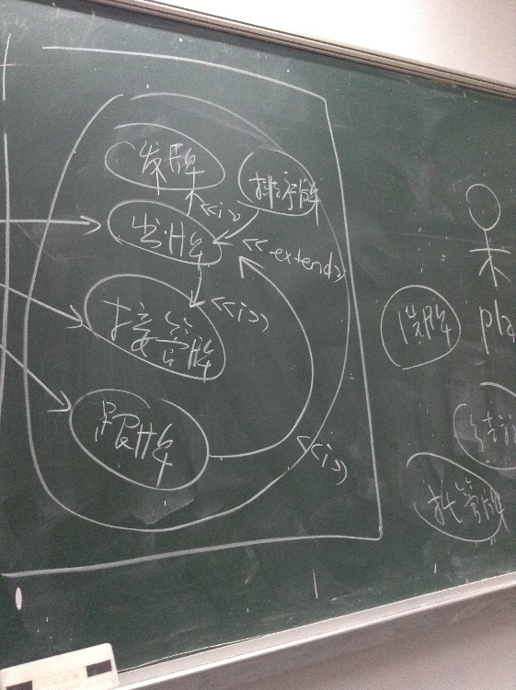
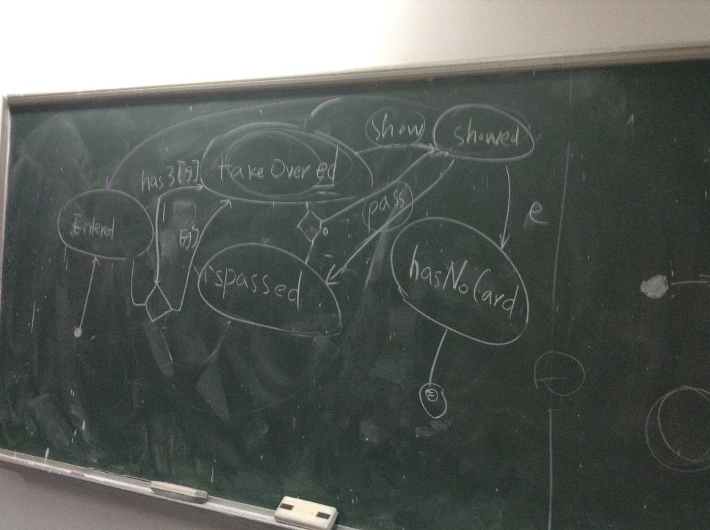
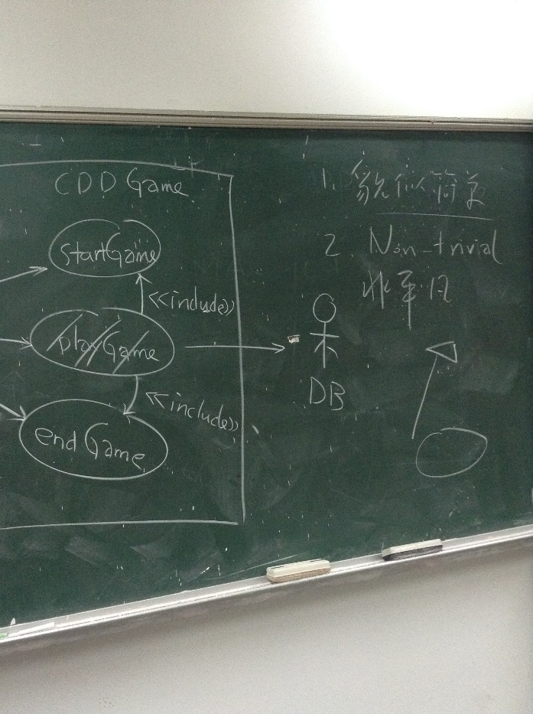
More Use Case Diagram and Activity Diagram
UC 2
UC 2 : “Activity Diagram”
UC 1
Notes:
创建用例图是貌似简单的
非平凡工作，不同的人对同一个系统
会产生不同的用例图
例如，有同学提出
锄大地游戏案例的主要用例图可以使用
这两个图来表示
请同学们思考到底对于锄大地游戏案例的需求分析而言
哪个用例图更加合适呢？
还有，有同学提出
可以使用
这个“活动图”来细化描述用例
因为能体现开始游戏，接管牌
过和出牌等用户动作
这些结果与前面呈现的结果有所不同
那么如何确定哪个用例图更加有效呢？
这是需要同学们在需求讨论会上
在实践中，不断灵活应用本次课提供的指导原则
才能逐渐掌握

Slide 37
Content Outline
Introduction of Use Case via a Brief Use Case Example.
Key Concepts about the Use Cases.
Introduce Use Case Specification via a Fully Dressed UC: Process Sale.
Guidelines about Use Cases.
Use Cases: A Case Study Applying UML Notations.
Process: Use Cases in Iterative Methods.
Notes:
下面介绍
过程：迭代方法中的用例

Slide 38
Process: How to Work With Use Cases in Iterative Methods?
Use cases are central to the UP and many other iterative methods. The UP encourages use-case driven development. This implies:
Functional requirements are primarily recorded in use cases (the Use-Case Model); other requirements techniques (such as functions lists) are secondary, if used at all.
Use cases are an important part of iterative planning. The work of an iteration is in part defined by choosing some use case scenarios, or entire use cases. And use cases are a key input to estimation.
Use-case realizations drive the design. That is, the team designs collaborating objects and subsystems in order to perform or realize the use cases.
Use cases often influence the organization of user manuals.
Functional or system testing corresponds to the scenarios of use cases.
UI "wizards" or shortcuts may be created for the most common scenarios of important use cases to ease common tasks.
Notes:
过程：在迭代方法中如何使用用例？
用例是UP和其它众多迭代方法的核心
UP提倡用例驱动开发 这意味着
功能需求首先记录在用例（用例模型）中
无论如何使用
其它需求技术 例如功能列表都是次要的
用例是迭代计划的重要部分
迭代的工作是通过选择一些用例场景或整个用例来（部分地）
定义的 同时，用例是预算的关键输入
用例实现驱动设计 也就是说 小组设计协作对象和子系统 是为了执行或实现用例
用例通常会影响用户手册的组织
功能或系统测试应当符合用例的场景
为重要用例的最常用场景 创建UI导航或快捷方式
可以方便执行常用任务

Slide 39
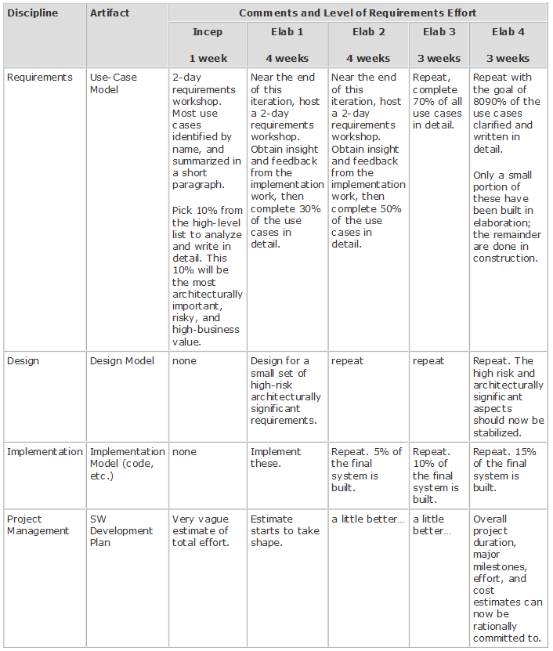
How to Evolve Use Cases and Other Specifications Across the Iterations?
Table 6.2.
Sample requirements
effort across the early iterations;
this is not a recipe.
Notes:
表 6-2 跨越早期迭代的需求工作任务示例
此例非实际解决方案
值得注意的是
当仅仅定义了约10%的需求时
技术小组就开始构建系统的产品化核心
并且该小组刻意拖延了进一步的深入需求工作
直到第一次迭代接近结束时为止
//下面是备注
这正是迭代开发与瀑布过程的关键区别
在了解所有需求之前
迅速开展对系统核心的产品级开发
在细化阶段的第一次迭代接近结束时
举行第2次需求讨论会
通过此次讨论会
详细编写了约30%的用例。
这种交错的需求分析得益于对少量的软件构建的反馈
这种反馈包括用户评估、测试和所改进的“知其所不知”
下面详细讨论表6-1中提供的信息
首先是初始阶段如何编写用例
在对POS系统的早期调查中
假设有为期 2 天的需求讨论会
定义大多数用例的名称
以摘要形式 编写
从高阶列表中选择 10% 的需求
这些用例具有重要的架构意义 风险和高业务价值
例如 POS系统的处理销售、处理退货等
其次实在细化阶段如何编写用例
细化阶段包括多次实践定量的迭代（如图所示 4 次迭代）
在 构建-反馈-调整 的循环中 逐步确定 80%-90% 的需求
逐步解决那些具有风险和不稳定的核心问题
获得稳定的，具有高风险、高价值和重要架构意义的设计模型
逐步地构建具有高风险 高价值
或具有重要架构意义的部分系统
例如，大概 15% 左右的最终系统
这时，我们可以提交合理的
总体项目进程、主要里程碑、工作量和成本预算了
剩余的一些次要的 10-20% 的用例
将在时间定量的构造阶段中
通过举行少数、简短的需求讨论会来创建

Slide 40
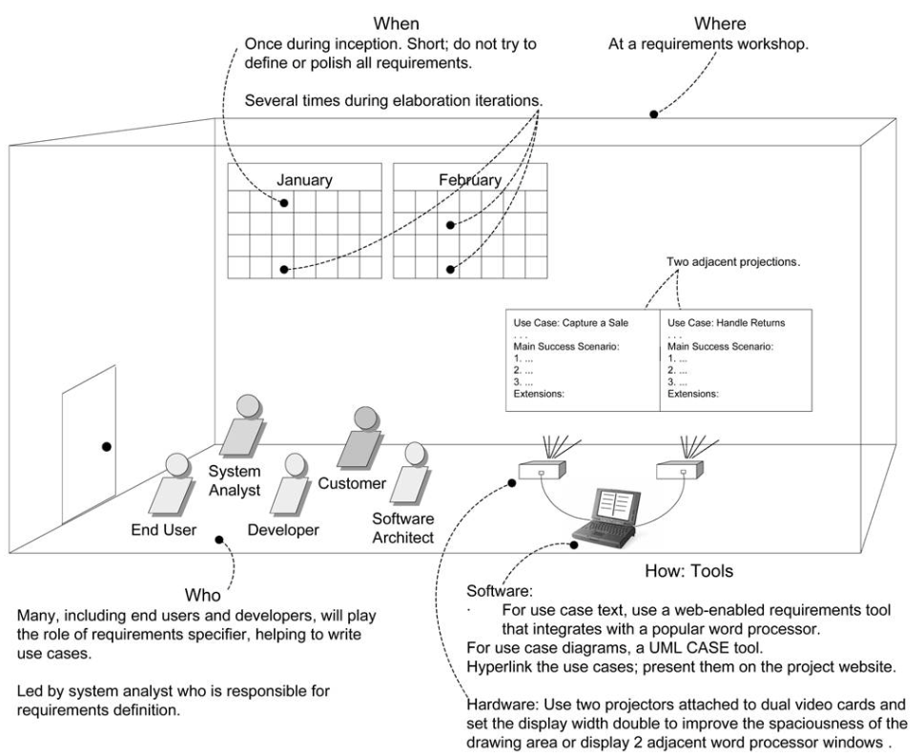
Writing Use Case: Who, When, Where and How.
In the UP, use case writing is encouraged in a requirements workshop.
Figure 6.7. Process and setting context for writing use cases.
Notes:
如图所示
给出了编写用例在时间和地点方面的建议
何时？
在初始过程中进行 1 次
简短的，不要试图定义或完善所有需求
何地？
在 UP 中，提倡在需求讨论会上 编写用例
如何做？
采用相关软件和硬件工具完成用例编写
何人？
许多人将作为需求定义者
以帮助编写用例，这些人包括
最终用户 开发人员 客户 系统分析员 软件架构师等
由系统分析员领导 并负责 需求定义

Slide 41
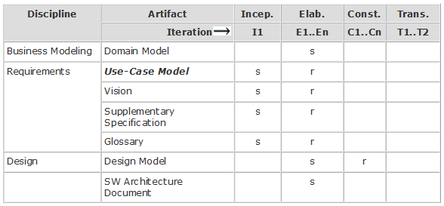
When Should Various UP Artifact (Including Use Cases) be Created?
Table 6.2. Sample UP artifacts and timing. s - start; r - refine
Notes:
UP 制品及其时限示例（S:开始；r：精化）
表 6-2 描述了一些UP制品，及其开始和精化的时间表示例
用例模型始于初始阶段
在这个阶段大概 只详细编写了 10% 具有重要架构意义的用例
大部分用例在细化阶段的迭代中进行编写
在细化阶段结束时
将完成大量详细用例和其它需求（在补充性规格说明中编写）
并为整个项目的预算提供真实的依据

Slide 42
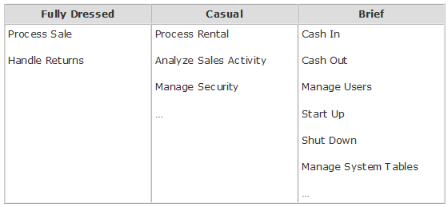
Case Study: Use Cases in the POS Inception Phase.
As described in the previous sections, not all use cases are written in their fully dressed form during inception. The Use-Case Model at this phase of the case study could be detailed as follows:
Notes:
如前面所述
初始阶段不需要以详述形式编写所有用例
POS 系统案例研究
在该阶段的用例模型 可以详述 如表格所示

Slide 43
Review : Use Case
What are Actors, Scenarios, Use Cases and Use-Case Model?
How to Find Use Cases? Please List the 4 Steps to Identify Use Case.
Please list the 3 Common Use Case Formats.
What Tests Can Help Find Useful Use Cases?
What are the Sections of Format Template for a Detailed Use Case?
What do the Sections of Use Case Template Mean?
Present 2 Use Case Examples to answer these questions.
Notes:
下面请大家 回顾一下本次课的知识内容
什么是参与者 场景和用例？
什么是用例模型？
参与者有哪三种类型？
如何找到用例？请列举标识用例的 4 个步骤
请列举用例的 3 种常用形式
什么样的测试 有助于发现有用的用例？
详细用例模板 包含哪些部分？
用例模板的这些部分含义是什么？
给出了2个用例的实例
来回答上述问题

Slide 44
Special Topics
Use cases are not just another requirements artifact, but are the central vehicle that drives requirements work, Why?
From the viewpoint of just the POS system, is the Cashier or Customer the Primary Actor?
Please present the UC: Play CDD Game in a Fully Dressed Style.
Notes:
最后，作为扩展知识域的学习
请大家课后学习
用例不仅仅是一种需求制品
而且是驱动需求工作的核心手段，为什么？
在 POS 系统中，主要参与者是收银员还是顾客？
请给出UC: Play CDD Game的细化描述

